Slide 1

M3 Presentation
By: Taja Hicks, Luis Morales,
Abigail Rodriguez Vazquez

Slide 2

Introduction to Blackbird
Some main Features include smart filters, polished PDF/CSV exports, and more
Blackbird is an OSINT tool that combines username and email searches across more than 600 platforms. This is done using AI to profile
By utilizing community-driven projects (like WhatsMyName), it lowers false positive rates and provides high-quality results

Slide 3

Strengths
Broad range of platforms (over 600)
AI integration and the option to choose whether you want to use it or not
Metadata Extraction
Multiple export options
Customizable filters

Slide 4


Weaknesses
Lookup time can be slower when searching more than 1 user/email
AI usage is limited to a number of searches each day
CLI can be hard to use for some

Slide 5



Examples of commands
//blackbird has 11 core commands that can be used with blackbird.py
Search for accounts by username.
--username <name>
Search for accounts by email.
--email <email>
List all supported platforms (600+ sites via WhatsMyName integration).
--list-sites
Display all results, not just found accounts.
--show-all
Export results to PDF
--PDF
port results to CSV.
--CSV
Generate an API key for AI-powered profiling.
--Setup-ai
Enable AI analysis of found accounts.
--ai
Use a proxy for requests.
—proxy <url>
Launch a local web server for GUI access.
--web
Read results from a saved JSON file
-f <filename>
Example Usage
python blackbird.py --username johndoe
python blackbird.py --email johndoe@example.com --pdf
python blackbird.py --list-sites
python blackbird.py --username johndoe --ai

Slide 6
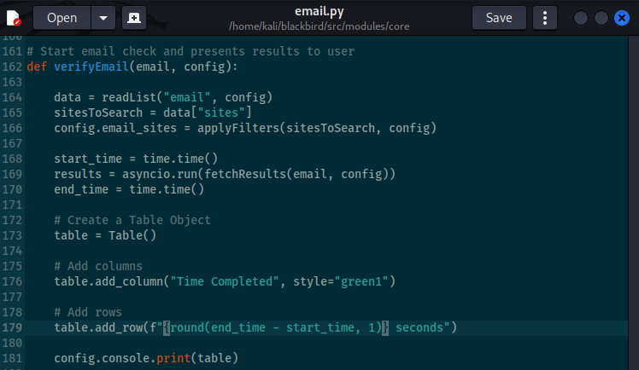
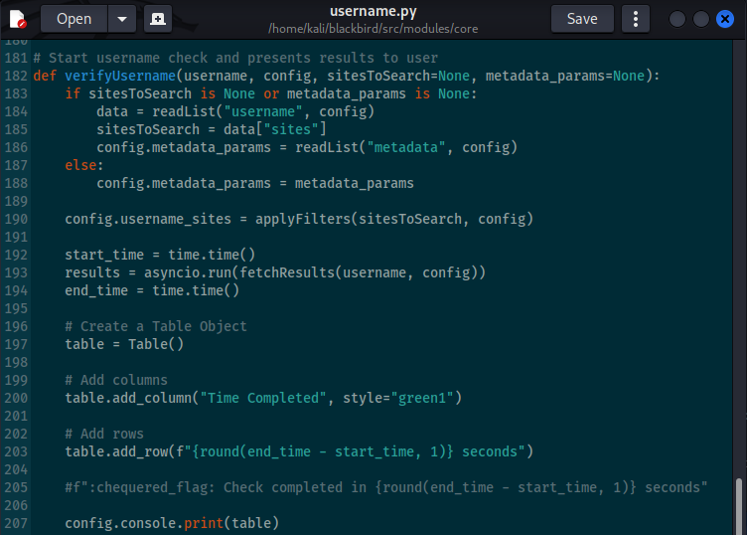
Code
email.py
username.py

Slide 7
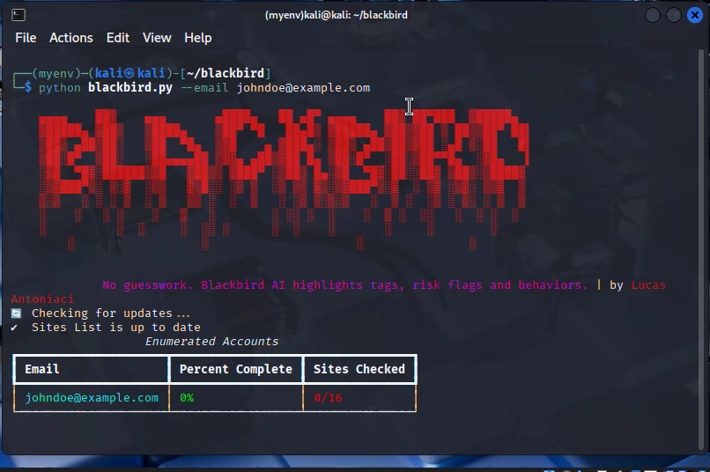
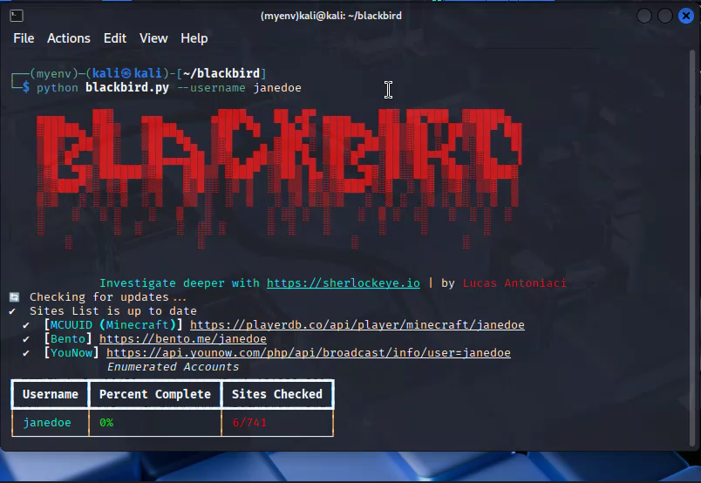
Contribution: CLI

Slide 8

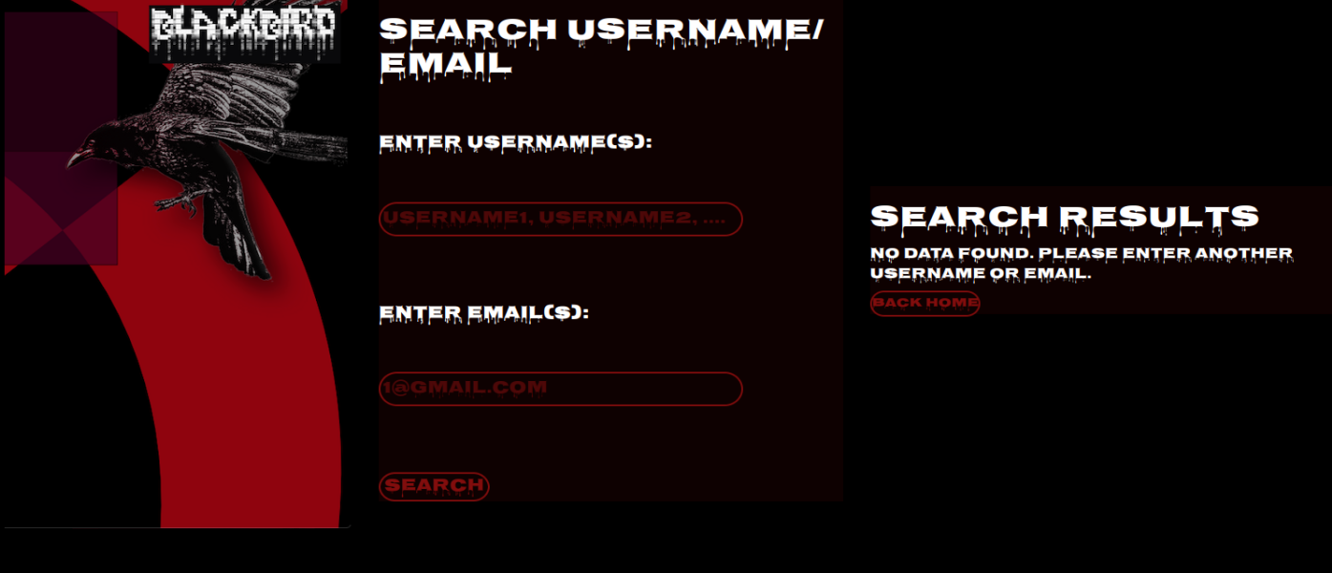
Contribution: Flask

Slide 9
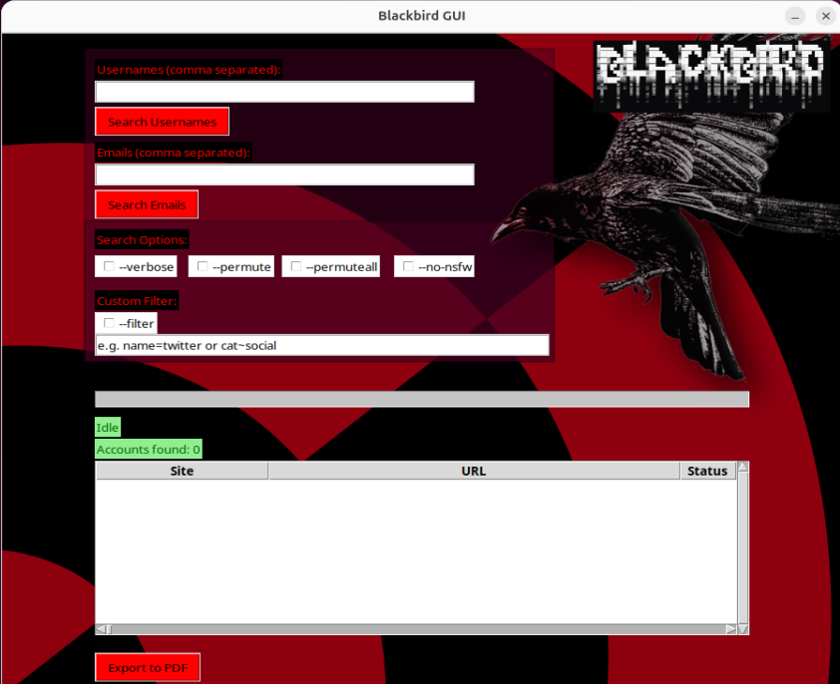
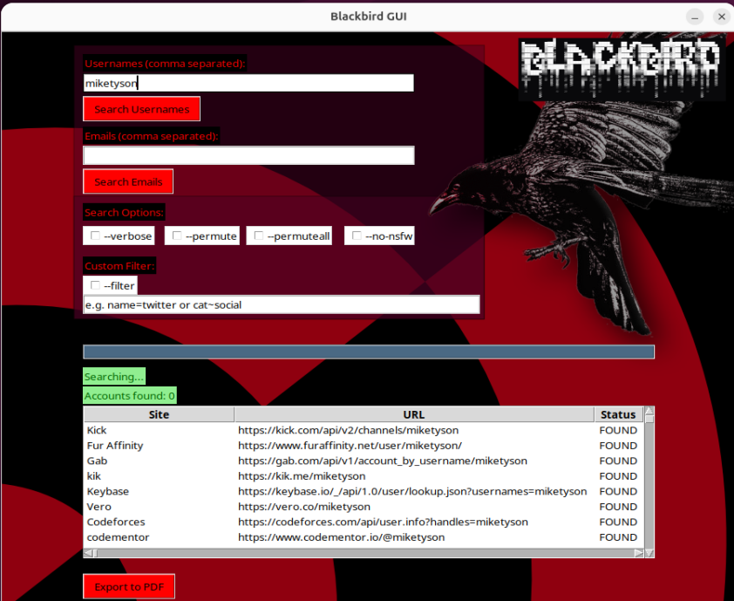
Contribution: Tkinter

Slide 10

Contribution: GUI

